Slide 1



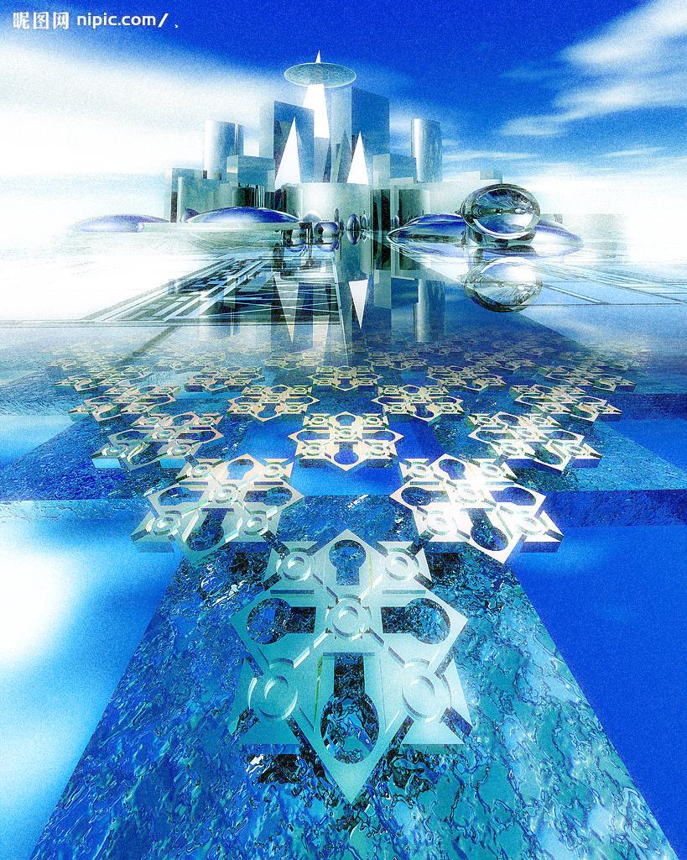

2013 Taiwan Society of Construction Engineers
The 11th Construction Engineering and Sustainable Energy Conference
Date: November 2, 2013
Location: Yuan Ze University, Building 7, Auditorium 3F
Topic:
A. Policy law of construction and management issues
B. Sustainable Architecture and Civil Engineering Issues
C. Materials and techniques of construction and civil engineering issues
D. Green building, energy and senior citizens’ welfare issues
Important dates:
Paper submission date: From day now
Abstract submission deadline: September 5, 2013
Abstract acceptance notification: September 15, 2013
Paper submission deadline: Octorber 10, 2013
Registration and payment:
1. Register as a member. Please go to Taiwan Society of Construction Engineers website:
http://www.tsce.org.tw
2. General member and life member: NT$1,500
Non-member: NT$2,000
3. Fail to pass the examination shall not refund any fees
4. Remittance to
Account name: Taiwan Society of Construction Engineers Chairman Han Tao-Yun
Account number: 007-10-002227-5 Union Bank of Taiwan, Sanchong Branch
Instruction:
Instruction and conference papers reporting information, please check the official website, the
format download by the conference website.
Cigao way:
Topics A and B, please Cigao to Dong -Ying Tzou doctoral (phone number: 886-972-123606)
e-mail：s1015211@mail.yzu.edu.tw
Topics C and D, please Cigao to Yu-Fu Chen doctoral (phone number: 886-963-091260)
e-mail ：s1015217@mail.yzu.edu.tw
Organizers:
Taiwan Society of Construction Engineers and Department of Chemical Engineering & Materials Science, Yuan Ze University
Sponsor : Department of Architecture, Feng-Chia University
Conference Website : http://www.tsce.org.tw

